Slide 1
Normalization
12

Slide 2
Contents
Normalization
Need of Normalization
Anomalies
Types of normal form

Slide 3
Approaches
There are two approaches to logical database design:
The Top-down approach: E-R Model
The Bottom-up approach: Normalization
The top-down approach
The E-R modeling technique is the top-down approach.
It involves identifying entities, relationships, and attributes, and drawing the ER diagram.
The Bottom-up approach:
Normalization is the bottom-up approach.
It is a step-by-step decomposing of complex records into simple records.

Slide 4
Normalization
Main objective in developing a logical data model for relational database system is to create an accurate representation of the data, its relationship and constraints. To achieve this objective we need to identify a suitable set of relations.
The process of simplifying complex data structures so that the resulting data structures will be more easily maintained and more flexible to meet present and future needs of the user. Data analysis uses a procedure called normalization to simplify entities, eliminate redundancy and build flexibility into the data model.
Normalization is a technique for organizing data in a database. It is important that a database is normalized to minimize redundancy (duplicate data) and to ensure only related data is stored in each table. It also prevents any issues stemming from database modifications such as insertions, deletions, and updates.

Slide 5
Normalization
Normalization rules divides larger tables into smaller tables and links them using relationships. The purpose of Normalization is to eliminate redundant (repetitive) data and ensure data is stored logically.
The inventor of the relational model Edgar Codd proposed the theory of normalization of data with the introduction of the First Normal Form, and he continued to extend theory with Second and Third Normal Form. Later he joined Raymond F. Boyce to develop the theory of Boyce-Codd Normal Form.
It is a technique for remove or reduce the redundancy from a table.

Slide 6
Why Normalize a Database?
There are a few reasons we would want to go through this process:
Make the database more efficient
Prevent the same data from being stored in more than one place (called an “insert anomaly”)
Prevent updates being made to some data but not others (called an “update anomaly”)
Prevent data not being deleted when it is supposed to be, or from data being lost when it is not supposed to be (called a “delete anomaly”)
Ensure the data is accurate
Reduce the storage space that a database takes up
Ensure the queries on a database run as fast as possible

Slide 7
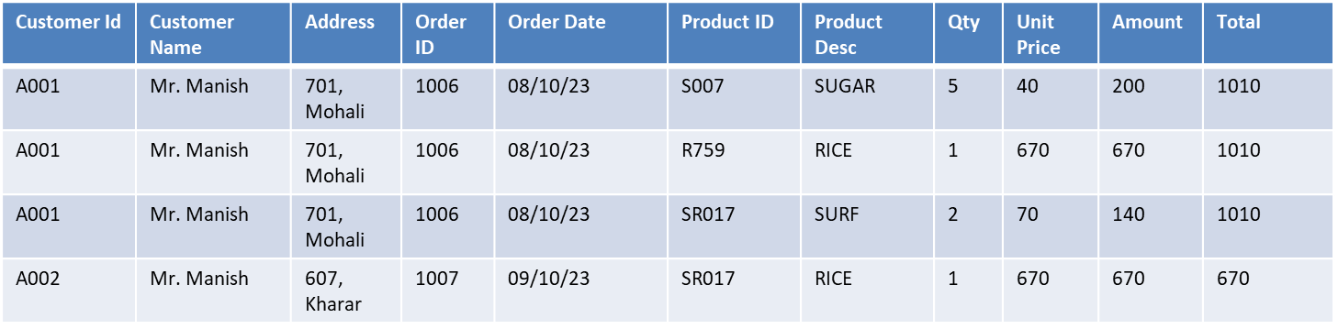
The issue in Un-normalized table
It is not possible to uniquely retrieve a record for Customer “Mr. Manish”
If you want to update the address of “Manish” then we have to update (4 records) including Cust_Id A001 & A002
If we want to add a new product “shampoo” to the store then it is difficult to insert.
If we want to delete any product from the store then all related records have to delete.

Slide 8
Anomalies
Anomalies means problems or inconsistencies that happened during the operation performed on the table.
Anomaly occurs for example
When all the data is stored in a single table.
When data is stored multiple times unnecessarily in the database.
Normalization is used to overcome(solve) the anomalies of the database.

Slide 9
Need of Normalization and anomalies
There are basically two types of redundancy or duplicity in the database one is row level another is column level.
Anomaly based on basic operations
Insertion Anomaly
Deletion Anomaly
Updation Anomaly

Slide 10
Anomalies
If a database design is not perfect, it may contain anomalies, which are like a bad dream for any database administrator. Managing a database with anomalies is next to impossible.
Update anomalies − If data items are scattered and are not linked to each other properly, then it could lead to strange situations. For example, when we try to update one data item having its copies scattered over several places, a few instances get updated properly while a few others are left with old values. Such instances leave the database in an inconsistent state.

Slide 11
Anomalies
Deletion anomalies − We tried to delete a record, but parts of it was left undeleted because of unawareness, the data is also saved somewhere else.
Insert anomalies − We tried to insert data in a record that does not exist at all.
Normalization is a method to remove all these anomalies and bring the database to a consistent state.

Slide 12
Anomalies example
Example: Suppose a manufacturing company stores the employee details in a table named employee that has four attributes: emp_id for storing employee’s id, emp_name for storing employee’s name, emp_address for storing employee’s address and emp_dept for storing the department details in which the employee works.
emp_id | emp_name | emp_address | emp_dept
101 | Rick | Delhi | D001
101 | Rick | Delhi | D002
123 | Maggie | Agra | D890
166 | Glenn | Chennai | D900
166 | Glenn | Chennai | D004

Slide 13
Anomalies example
Update anomaly: In the above table we have two rows for employee Rick as he belongs to two departments of the company. If we want to update the address of Rick then we have to update the same in two rows or the data will become inconsistent. If somehow, the correct address gets updated in one department but not in other then as per the database, Rick would be having two different addresses, which is not correct and would lead to inconsistent data.

Slide 14
Anomalies example
Insert anomaly: Suppose a new employee joins the company, who is under training and currently not assigned to any department then we would not be able to insert the data into the table if emp_dept field doesn’t allow nulls.
Delete anomaly: Suppose, if at a point of time the company closes the department D890 then deleting the rows that are having emp_dept as D890 would also delete the information of employee Maggie since she is assigned only to this department.
To overcome these anomalies we need to normalize the data.

Slide 15
Need of Normalization
SID | Sname | CID | CName | FID | FName | FCity
101 | Pushkar | C101 | C++ | F101 | Ajit | Chandigarh
102 | Manik | C102 | DBMS | F102 | Ganesh | Bhopal
103 | Abhishek | C101 | C++ | F101 | Ajit | Chandigarh
104 | Ram | C101 | C++ | F101 | Ajit | Chandigarg
105 | Ishaan | C103 | Oracle | F103 | Rahul | Indore
106 | Ram | C104 | Java | F104 | Imran | Rajpura
107 | Ram | C105 | C | F105 | Kaushik | Panchkula

Slide 16
Need of Normalization
SID | Sname
101 | Pushkar
102 | Manik
103 | Abhishek
104 | Ram
105 | Ishaan
106 | Ram
107 | Ram
CID | CName
C101 | C++
C102 | DBMS
C103 | Oracle
C104 | Java
C105 | C
Redundancy
Insertion Anomaly
Deletion Anomaly
Updation Anomaly
Storage space
Efficiency
FID | FName | FCity
F101 | Ajit | Chandigarh
F102 | Ganesh | Bhopal
F103 | Rahul | Indore
F104 | Imran | Rajpura
F105 | Kaushik | Panchkula

Slide 17
Contents
Unnormalized form
First normal form(1NF)
UNF to 1NF

Slide 18
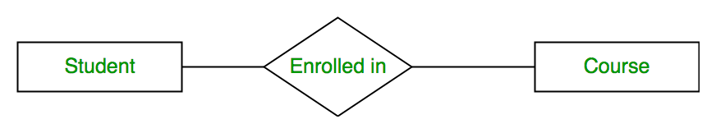
ER Diagram

Slide 19
Unnormalized form
Student
SID | SName | SAddress | Mobile
101 | Animesh | Bhopal, 462021 | 8654321210, 9123567189, 9645197662
102 | Rahul | Indore, 442021 | 9826197624
103 | Ganesh | Chandigarh, 131178 | 9965421972, 9234908712
104 | Kapil | Indore, 442021 | 8654321210

Slide 20
First way to convert table in 1NF
Student
SID | SName | City | Pincode | Mobile
101 | Animesh | Bhopal | 462021 | 8654321210
101 | Animesh | Bhopal | 462021 | 9123567189
101 | Animesh | Bhopal | 462021 | 9645197662
102 | Rahul | Indore | 442021 | 9826197624
103 | Ganesh | Chandigarh | 131178 | 9965421972
103 | Ganesh | Chandigarh | 131178 | 9234908712
104 | Kapil | Indore | 442021 | 8654321210

Slide 21
Second way to convert table in 1NF
Student
SID | SName | City | Pincode | Mobile1 | Mobile2 | Mobile3
101 | Animesh | Bhopal | 462021 | 8654321210 | 9123567189 | 9645197662
102 | Rahul | Indore | 442021 | 9826197624 | Null | Null
103 | Ganesh | Chandigarh | 131178 | 9965421972 | 9234908712 | Null
104 | Kapil | Indore | 442021 | 8654321210 | Null | Null

Slide 22
Third way to convert table in 1NF
Student
SID | Mobile
101 | 8654321210
101 | 9123567189
101 | 9645197662
102 | 9826197624
103 | 9965421972
103 | 9234908712
104 | 8654321210
SID | SName | City | Pincode
101 | Animesh | Bhopal | 462021
102 | Rahul | Indore | 442021
103 | Ganesh | Chandigarh | 131178
104 | Kapil | Indore | 442021

Slide 23
Points
A relation is in 1NF if it does not contain multivalued attribute and composite attributes.
Every attribute value is atomic.
All the cells are single valued, all entries in any column are of the same kind.
Each column has a unique name (No duplicate columns allowed), but the order of the columns and rows is not important.
So a relation is in 1NF if and only if all underlying domains contain atomic values only.
"A relation schema R is in 1NF, if it does not have any composite attributes,multivalued atttribute or their combination."
The objective of first normal form is that the table should contain no repeating groups of data.

Slide 24
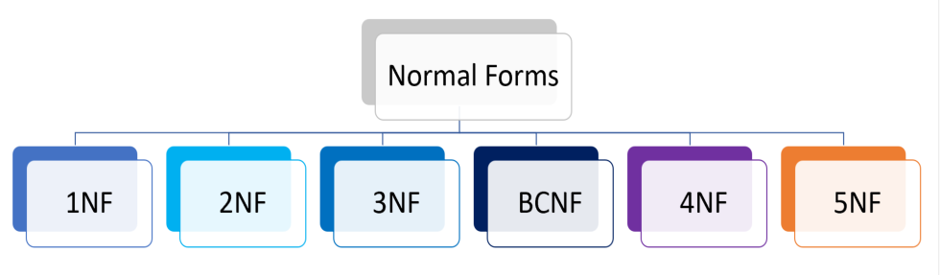
Types of Normal form

Slide 25
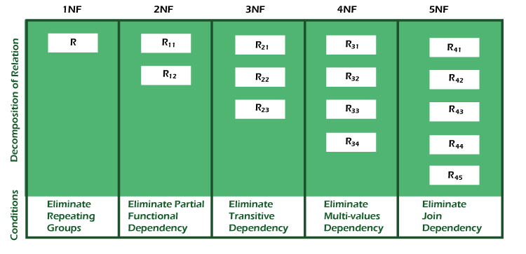

Slide 26
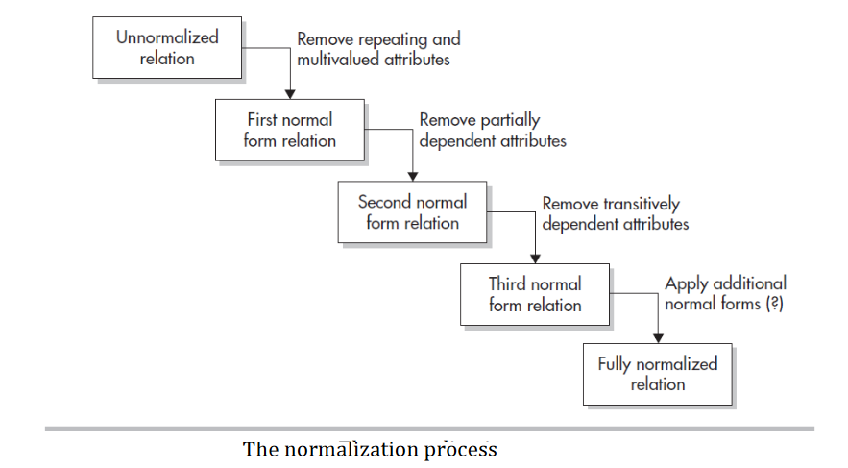
Normalization process

Slide 27


